Slide 1

International Lead Time to Tender
By Amy Nestingen

Slide 2
International Lead Time Legs
Manufacturing Date
Containerization Date
Sail Date
Delivery Date

Slide 3
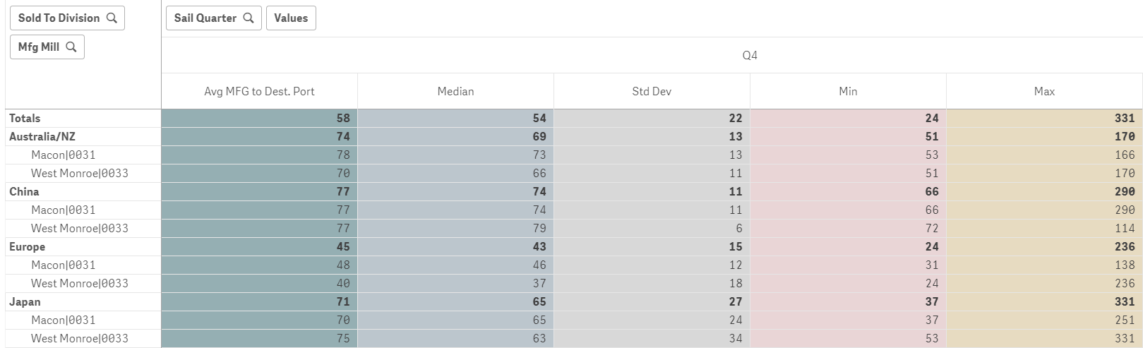
Analysis: Summary of Statistics

Slide 4
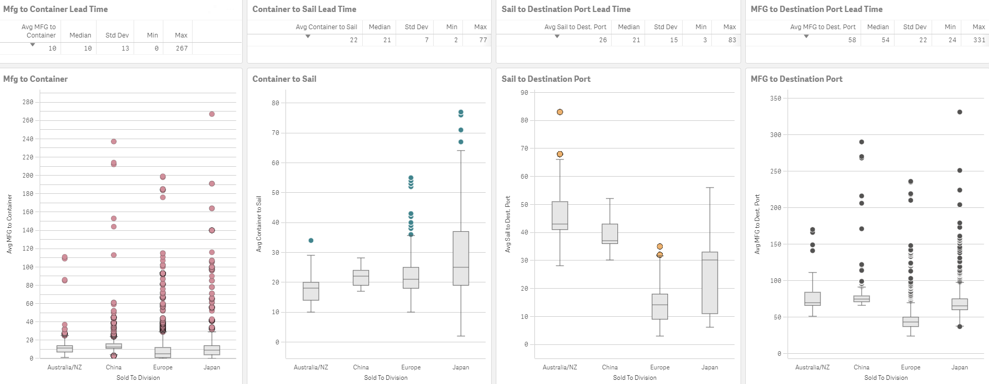
Analysis: Box Plots

Slide 5
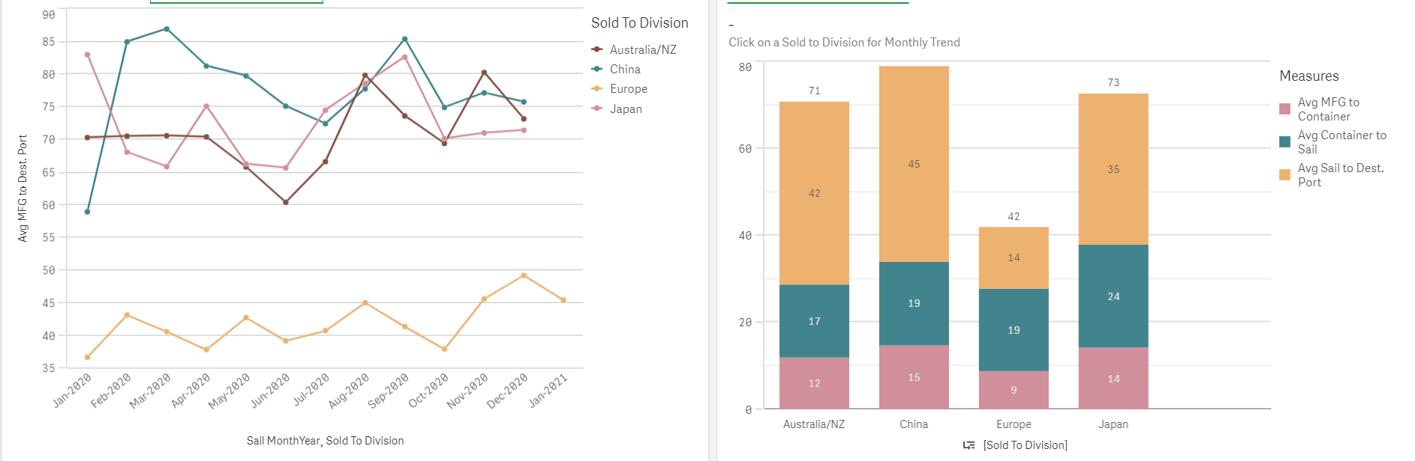
Model

